Slide 1

SENSE : InScene

Slide 2

Video
https://www.youtube.com/watch?v=2bpWs7VoWtI

Slide 3
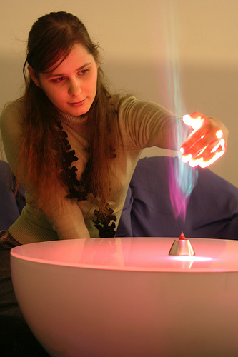
Introduction
InScene is a fantastic communication device which uses incenses.
Sender: implant a message in incense (ICKO) with a mobile phone.
Receiver: lights the incense and places it on the table (KORO).
Receiver is able to enjoy：
aroma filled in the room；
lighted smoke；
shooting stars projected on the ceiling.

Slide 4
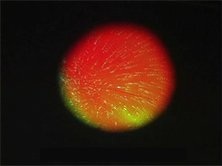
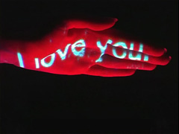
Introduction(2)
By holding or waving a hand over the smoke, the sender's message can be viewed.
After the incense dies out, the receiver can soak in the remaining aroma.
InScene supports communication taken place in the space provided by InScene.

Slide 5
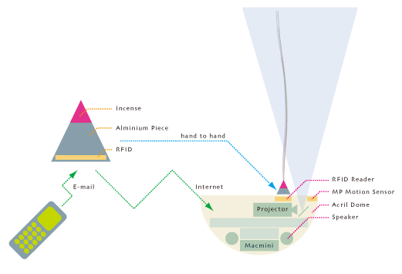
System of InScene
ICKO
KORO
The shape of KORO is imaged as the moon.
KORO changes from a full moon to a half moon depending on the angle of the receiver's view.
The shape of ICKO is imaged as Apollo rocket.
Each message reaches the receiver as Apollo reached the moon.

